Slide 1
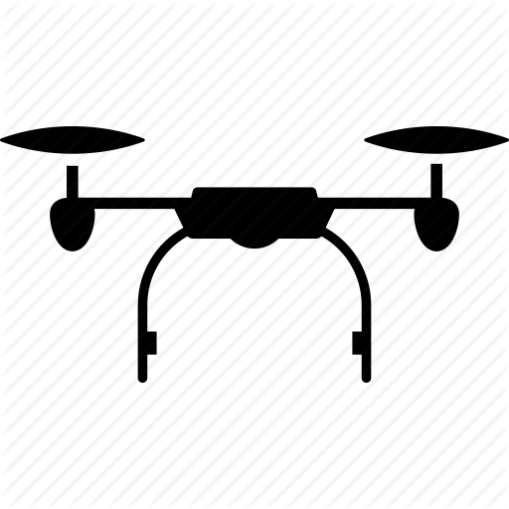

Seismic Drone Data Acquisition System
Seismic Drone(Geophone Sensors +Seismic Recorder + Data Storage +Battery)
Source (Veibroseis setup, Motor with Piston)
1.
2.
3.
23.
24.
Vibrating Plate(Epicenter)
Vibrational
Waves

